Slide 1
Exploratory Data Analysis (EDA)

Slide 2
Overview
Define exploratory data analysis (EDA)
Discuss EDA techniques
Demonstrate EDA techniques in R
Reference EDA techniques in ArcMap and additional extended techniques in R

Slide 3
Definition
Coined by John Tukey in 1977, EDA represents:
“an approach/philosophy for data analysis that employs a variety
of techniques (mostly graphical) to maximize:
insight into a data set;
uncover underlying structure;
extract important variables;
detect outliers and anomalies;
test underlying assumptions;
develop parsimonious models; and
determine optimal factor settings (Filliben, 2004).”
Notes:
In 1977, pencil and graph paper were the standard tools for performing this work.
Today, producing graphical output is easily available and much more intuitive to gaining an understanding of your data than the numerical methods stressed in many text books.

Slide 4
Introduction
Two types of EDA:
Non-graphical
descriptive statistics such as mean, median, IQR, standard deviation, skewness, kurtosis, correlation/covariance matrices, moran’s I
Graphical
histograms, kernel density plots, qqplots, scatterplot matrices, boxplots
Notes:
To be complete, there are 4, but the distinction is
Types of EDA:
Univariate Non-graphical
descriptive statistics such as mean, median, IQR, standard deviation, skewness, kurtosis, moran’s I
Univariate Graphical
histograms, kernel density plots, qqplots
Multivariate Non-graphical
correlation and covariance matrices
Multivariate Graphical
scatterplots, boxplots
Graphical are the most powerful to gain insight into data
Numerical is useful for reporting, determining threshold values for modeling or populating ranges and central tendencies

Slide 5
Inspect your data
Look before leaping, assess data completeness:
1. Are horizon designations current and standardized?
2. Are data elements of interest populated?
3. What are the magnitudes of missing values?
4. What are the data types you are exploring?
5. Fix, modify or exclude and document accordingly

Slide 6
Exercise Instructions
Create a folder, e.g. *\eda_examples
Download this file to the “eda_examples” folder:
https://github.com/ncss-tech/stats_for_soil_survey/blob/master/data/exploratory_data/eda_examples.zip
Unzip eda_examples.zip
These sample scripts will be used throughout this module
Set your workspace to *\eda_examples
Most exercises have 2 parts:
1) using the “canned” data in the scripts
2) using data from your selected set
The second part will require you to copy the provided script and edit to conform to the features and properties of the soils in your selected set

Slide 7
Exercise Data Inspection
Add “0_R_readtable_NULL_short_example.R”
Run, then Q&A
Add “0_plot_missing_data.R”
Run, then Q&A
Add your selected set using fetchNASIS
Run these QC checks
get('sites.missing.pedons', envir=soilDB.env)
get('dup.pedon.ids', envir=soilDB.env)
get('bad.pedon.ids', envir=soilDB.env)
get('bad.horizons', envir=soilDB.env)
Notes:
Might be a repetition of Ch. 2, but, so what.
What variables have missing data?
How many?
Do other soils have missing data?
How much?
Ideas – load loafercreek
1) How many horizons in dataset?
2) How many A, B or C horizons?
3) Any sand silt, clay, co frags etc wi missing values?
4) How many?
5) Maybe do generalized horizons
6) How many sites have no x,y coords?

Slide 8
Descriptive Statistical Definitions
Mean – arithmetic average
Median – midpoint
Mode – most frequent value in a dataset
Standard Deviation – variation about the mean
Interquartile Range – statistical dispersion
Kurtosis – peakedness of the data distribution
Skewness – symmetry of the data distribution
Spatial Autocorrelation – correlation of a variable with itself through geographic space
Notes:
Other measures not listed
Minimum
Maximum
Range – Maximum - minimum

Slide 9
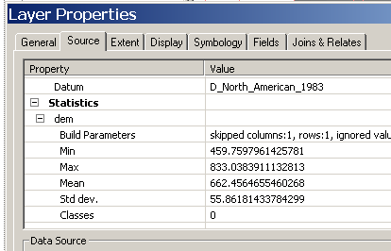

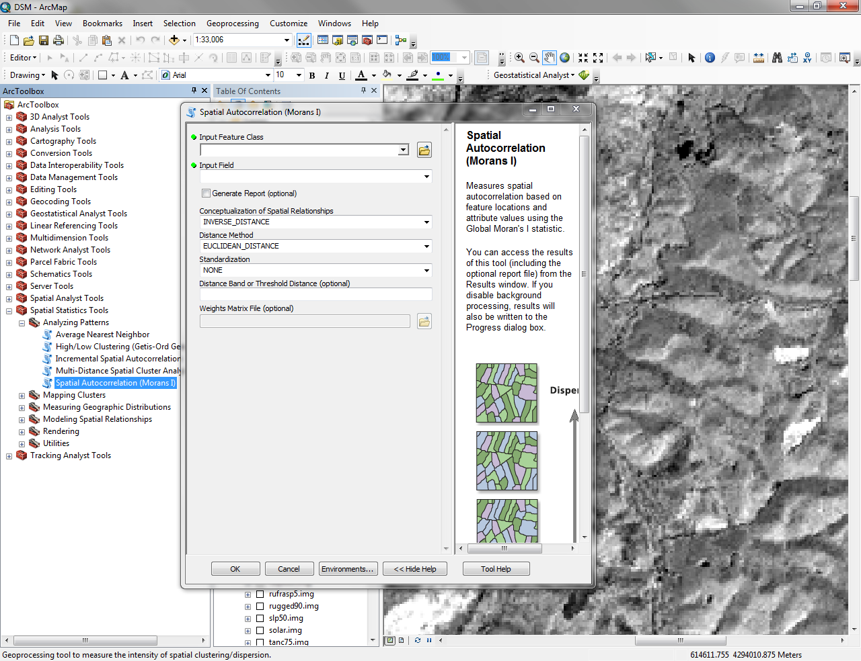

Descriptive Statistics in ArcGIS
Right-click on layer
and select Properties
Hit Source Tab and
scroll down to Statistics
Select raster layer in Spatial Analyst
Toolbar then select histogram
(graph dependent on symbology)
Double-click Spatial Autocorrelation tool under the Spatial Statistics and Analyzing Patterns toolboxes
Notes:
Don’t ignore the tools hidden in plain sight – take advantage of these tools in ArcGIS

Slide 10
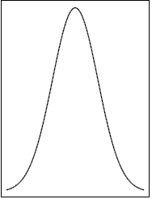
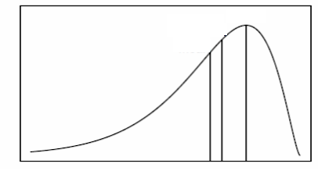
Distributions
Mean
Median
Mode
Mode
Mode
Mean
Median
Normal Distribution (no skew or kurtosis)
Bimodal Distribution
Mode
Mode
Median
Median
Mean
Mean
Negatively skewed (skewed to the left)
Positively skewed (skewed to the right)
Notes:
Normal – mean, median and mode are equal, distribution is symmetrical with a defined variance
Multi-modal – multiple peaks, i.e. modes
Skewed – mean, median and mode are different, distribution is asymmetrical, with the mean either less than or greater than the median.

Slide 11
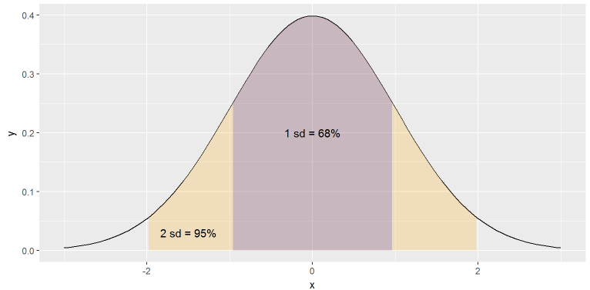
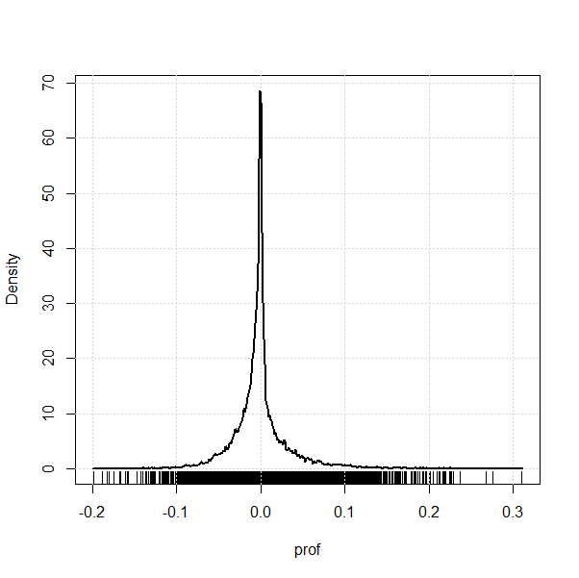
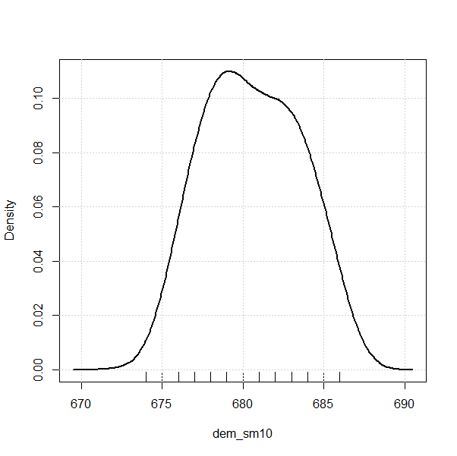
Distributions
High kurtosis
(high peakedness)
Normal
Low kurtosis
(low peakedness)
Notes:
Common example
USA male height ~ 5’ 9.5”
SD = 2”

Slide 12
Normality
Most statistical tests and models assume that data are normally distributed, i.e. parametric. When this assumption is violated, the results of the test or model could be inaccurate. There are two ways to handle data that are not normally distributed:
1. transform data so that it is normally distributed
2. use nonparametric tests and statistics
Notes:
The descriptive statistics like mean, standard deviation, IQR, skewness, and kurtosis describe the distribution of the data. A normal distribution has a mean of 0, standard deviation of 1, skewness of 0, and kurtosis of 0.
You can correct for normality in multiple ways:
delete outliers, log-transform, square root transform,
Parametric statistics are easier to interpret and usually have higher predictive power than nonparametric statistics (Hoskin).
It is best to use nonparametric statistics when:
data cannot be transformed to have a normal distribution
there is a small sample size (n<30)

Slide 13
Distributions - Graphical
Histogram
Density plot (aka kernel density plot)
Quantile-quantile plot (QQplot)
Boxplot (aka Box and whisker plot)
Circular
Notes:
Just list

Slide 14
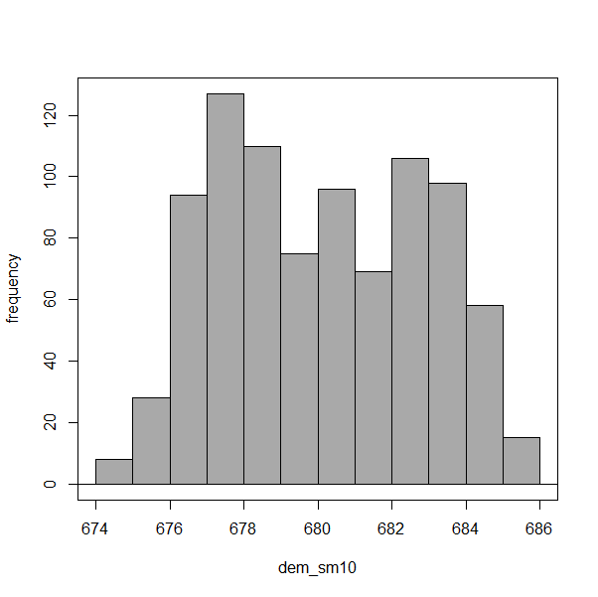
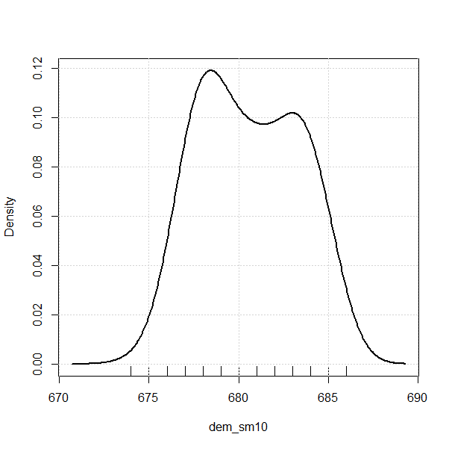
Distributions - Graphical Histograms and Kernel Density Plots
Histogram
Kernal Density Plot
Notes:
The shape of a histogram is dependent on the number of “bins” selected
You may have experimented with this in the “Getting Started” exercise. If we only specify 3 bins, the histogram would approach a gross approximation of a normal distribution
The kernel density plot interpolates an idealized smooth line of the distribution and its shape is dependent on the parameters used
The R defaults are typically good enough, but the adjustments will render a plot that increases in smoothness with increasing bandwidth.

Slide 15
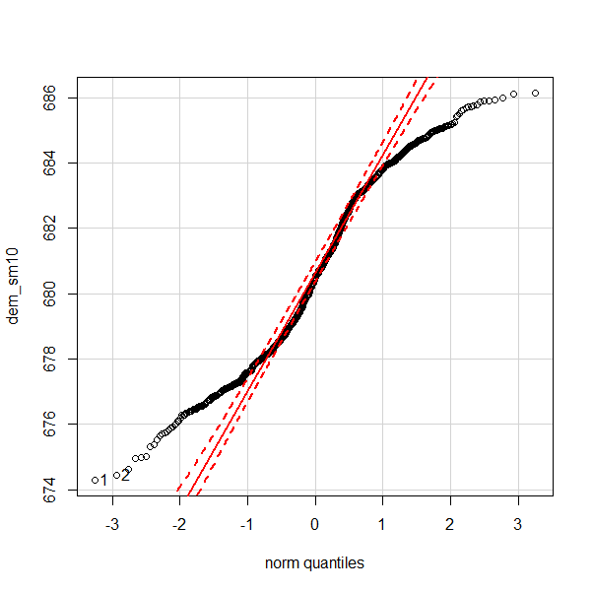
Distributions - Graphical Quantile-quantile Plots
Density plot of same data
Notes:
QQ plot is a standardization of your data where 0 is the mean, 1 and 2 are 1 and 2 standard deviations.
The standard score of a raw score x ^{[1]} is
Z = x- μ/σ
where:
μ is the mean of the population;σ is the standard deviation of the population.
If data is normal, there will be a 1:1 relationship between sample data and the data from a normal curve. Sample data will be points, normal is the solid line.
If there is deviation, it is usually on the low or high end, which may be ok and close enough to normal to consider as such.
If there is deviation from the normal line around 0, data is definitely not normal.

Slide 16
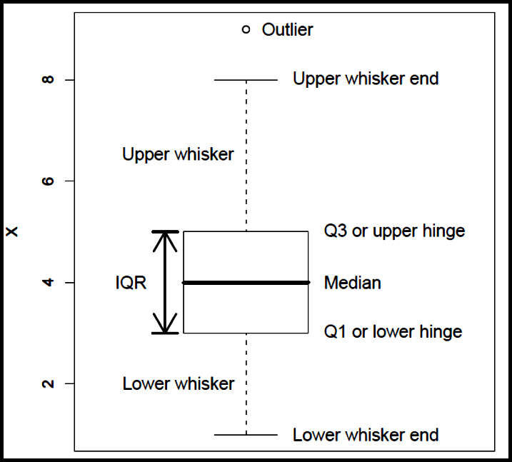
Boxplots
Seltman (2009)
Notes:
Boxplots have a standard layout with 6 parts:
Q1 = 1st quartile = 25th percentile
Median = Q2 = 50th percentile = midpoint of data values
Q3 = 3rd quartile = 75th percentile
IQR = Interquartile Range = (Q3 – Q1). This is the guts of the distribution at 50%, so it is tighter than 1 standard deviation of a normal distribution
Whiskers are typically the lowest and highest datum within 1.5 * IQR
Outliers – data points beyond whiskers

Slide 17
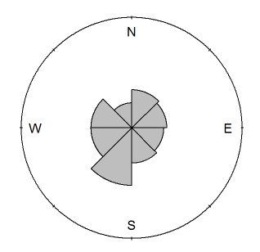
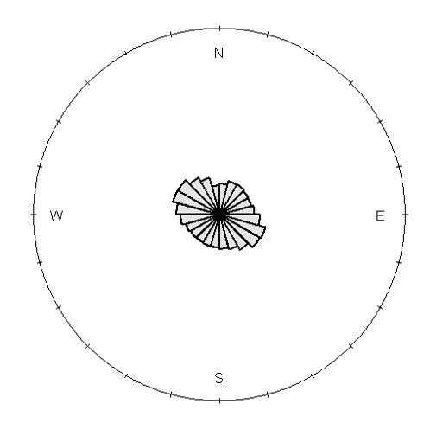
Distributions - Graphical Rose Plots
Notes:
Since aspect data is circular, plots like a Rose Diagram are useful for visualizing distributions of slope aspect
Time is another cyclic data type.
Plots include:
Rose diagram aka Circular histogram
Radar/Radial plot – correlate of a kernel density plot

Slide 18
Exercise Data Distributions
Run:
2_distribution_graphs.R
3_mean_median.R
4_distribution_qq_box.R
5_relationship_scatter.R
6_stacked_bar.R
Q&A on scripts 2, 3, 4, 5, 6
Repeat using your own data
Notes:
Keeping with loafercreek
Generalized horizons, maybe
Density plot of A horizon thickness
Density plot of clay or sand content for B
Boxplot by group of A horizon clay and B horizon clay
Qqplot of some variable
Etc, something like this that gets them doing things that are commonly asked

Slide 19
Central Tendency
Measures used to determine the mid-point of the range of observed values
The mean and median are the most commonly used measures for our purposes
In NASIS speak, this should ideally be equivalent to the representative value (RV) for numeric and integer data – is it?

Slide 20
Central Tendency
Mean – arithmetic average
(sum of values)/total number of observations
Median – the value of middle data point in a dataset
Mode – the most frequently occurring value in a data set

Slide 21

Central Tendency - numerical
Numerical summaries in R
summary(x), e.g.
mean(x)
median(x)

Slide 22
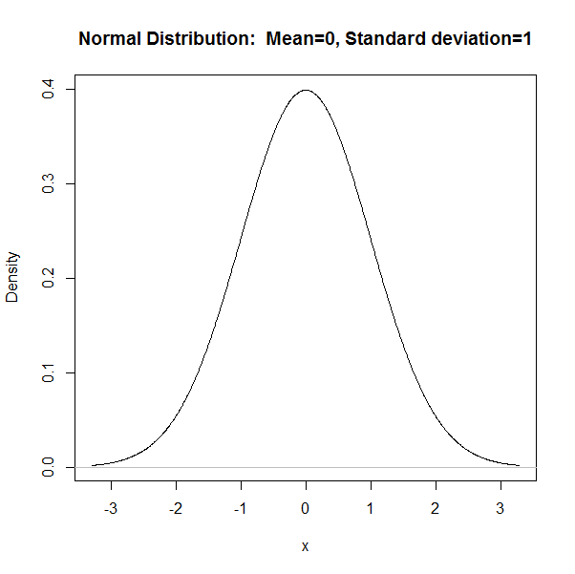
Central Tendency
Notes:
Where is the Mean in this distribution?
Where is the Median?
Where is the Mode?
Is the Mean representative for this distribution?

Slide 23
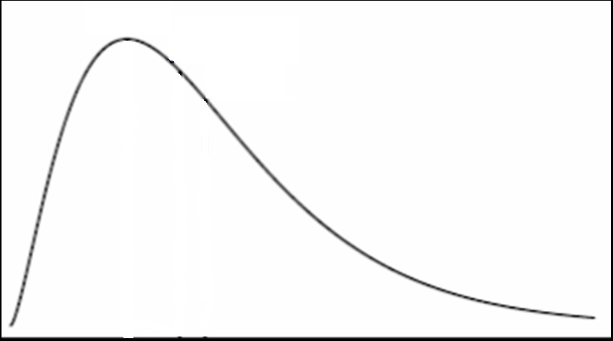
Central Tendency
Notes:
Where is the Mean in this distribution?
Where is the Median?
Where is the Mode?
Is the Mean representative for this distribution?
What is an RV in NASIS?
Where did it come from?
How is it determined?
How do you determine the Low and High values?
What do we tell users how these values are determined and what they represent?
How would our endeavor be different if our predecessors had chosen something other than Mode to define “Typical” entities?

Slide 24
Boxplots
Seltman (2009)
Notes:
Median = Q2 = 50th percentile = midpoint of data values
The boxplot provides indication of data distribution based on where the median is in relation to the IQR and the whiskers

Slide 25
Exercise Central Tendency
Run:
1_descriptive.R
7_box_density_by_group.R
8_box_multivariate_by_horizon.R
Q&A on scripts 1, 2, 3, 4, 7, 8
Repeat using your own data
Notes:
Keeping with loafercreek
Generalized horizons, maybe
Summary of A horizon thickness
Density plot of clay or sand content for B with abline of mean and median
Etc, something like this that gets them doing things that are commonly asked

Slide 26
Dispersion
Measures used to determine the spread of values around the mid-point
Determine if samples are spread widely across the range of observations or concentrated near the mid-point
Standard Deviation, Coefficient of Variation and Interquartile Range are the most commonly used measures

Slide 27


Dispersion
Standard Deviation =
Coefficient of Variation =
unitless representation of SD
Interquartile Range = 75th percentile – 25th percentile

Slide 28
Dispersion
Percentiles (a.k.a. quantiles) – division of data values into bins of respectively specified intervals
Default for R = min, 25th, 50th, 75th, max
The Interquartile Range = 75th – 25th
a.k.a. – the guts of the data
Using percentiles, what would be a reasonable
proxy of 1 Standard Deviation?

Slide 29

Dispersion - numerical
Numerical summaries in R
sd(x), e.g.
IQR(x)
kurtosis and skewness – available in other packages, write a function, OR
Look at a plot

Slide 30
Dispersion - graphical
High kurtosis
(high peakedness)
Low kurtosis
(low peakedness)
Normal
Notes:
Degree of dispersion with left graph?
SD of left graph?
Degree of dispersion right graph?
SD of right graph?
Given the dispersion, how much information is conveyed about these various populations if you have a value near the mid-point?

Slide 31
Boxplots
Seltman (2009)
Notes:
A wide IQR indicates a wide variance, a big, broad distribution/curve
IQR = Interquartile Range = (Q3 – Q1). This is the guts of the distribution at 50%, so it is tighter than 1 standard deviation of a normal distribution
Whisker length indicates how many low and high values are present
Whisker symmetry indicates the skewness of the distribution
Outliers – data points beyond whiskers

Slide 32
Exercise Dispersion
Run:
9_depth_distribution_multivariate.R
Q&A on scripts 1, 2, 7, 8, 9
Repeat using your own data
Notes:
Keeping with loafercreek
Generalized horizons, maybe
Summary of some horizon thickness
sd of horizon thickness
sd of horizon variable
IQR for same
Percentiles of a horizon variable, e.g. 5, 50, 90
This step may not be canned script, but they could do things for the next step
For several variables list reasonable lo, rv, hi
This could be the “crowning” exercise of this module, where the pitch for robust metrics be used for lo, rv, hi rather than rote measures, or tacit knowledge
Etc, something like this that gets them doing things that are commonly asked

Slide 33
Multivariate Non-graphical
Correlation - a quantitative measure of the relationship of two or more variables
assess predictability and multicolinearity of variables
Covariance - a quantitative measure of the similarity between two variables with respect to location and mean value
Notes:
Examining the relationships among variables is an important step
We may be interested in how variables are related to each other, for example,
How does O horizon thickness vary with slope gradient, wetness index, solar insolation, curvature etc

Slide 34
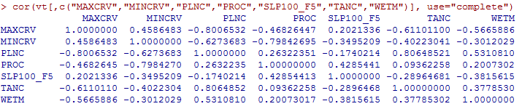
Multivariate Non-graphical Correlation
Correlation is a representation how two variables are related
Results range between -1 and 1 (perfect inverse to perfect positive correlation)
Values close to zero indicate the two variables are uncorrelated
Notes:
Who cares?
You do, if two variables are highly correlated, you only need one to help explain the variability of the problem you are investigating. Otherwise, you are essentially double-counting, leading to overly confident predictions
In the above matrix – tangent and plan curvature are highly correlated. What is the correlation coefficient of profile curvature and tangent curvature ? PLNC and TANC (A - ~ 81%)
Pearson’s Coefficient: parametric technique that measures the degree of linear relationship between data
Spearman’s Rho: non-parametric technique that quantifies the degree of linear association between the ranks of data. Interp similar to Pearson’s, i.e. proportion of variability accounted for. More sensitive to outliers.
Kendall’s Tau: non-parametric measure of association based on the number of concordances and discordances in paired observations. Better for small sample sizes, less sensitive to outliers

Slide 35
Multivariate Graphical
Scatterplots – graphical display of one variable plotted on the horizontal axis and another on the vertical axis
visually assess relationship between variables
Boxplots – a visual representation of median, quartiles, symmetry, skew, and outliers
Notes:
Boxplots rely on robust statistics like median and IQR rather than more sensitive ones like mean and standard deviation.

Slide 36
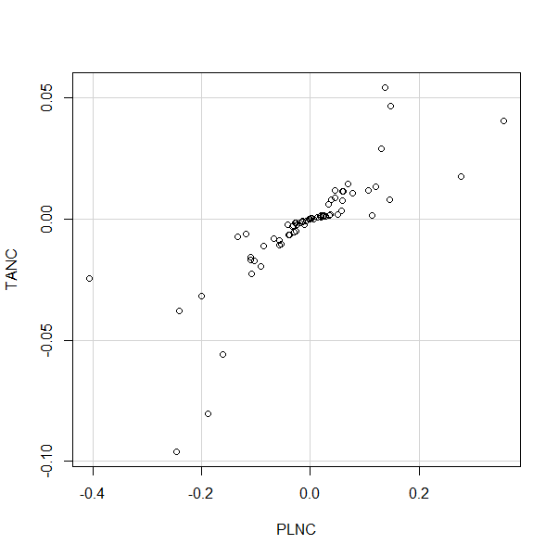
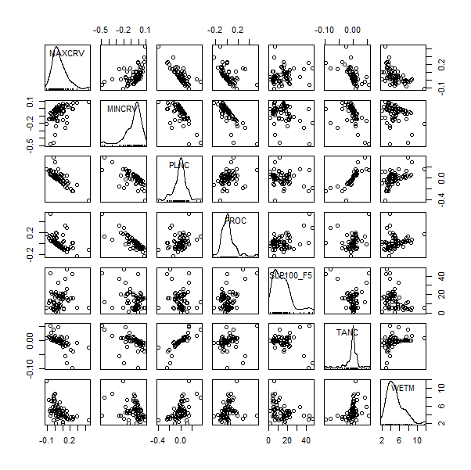
Multivariate Graphical - Scatterplots
Simple scatterplot
Scatterplot matrix
Notes:
Scatterplot is a quick way to visualize the relationships between variables:
What is the relationship between plan curvature and minimum curvature (PLNC MINC)?
Is it positive or negative?
Correlated or not?
Linear or not?
Identify a couple variables that do not appear to be correlated very well?

Slide 37
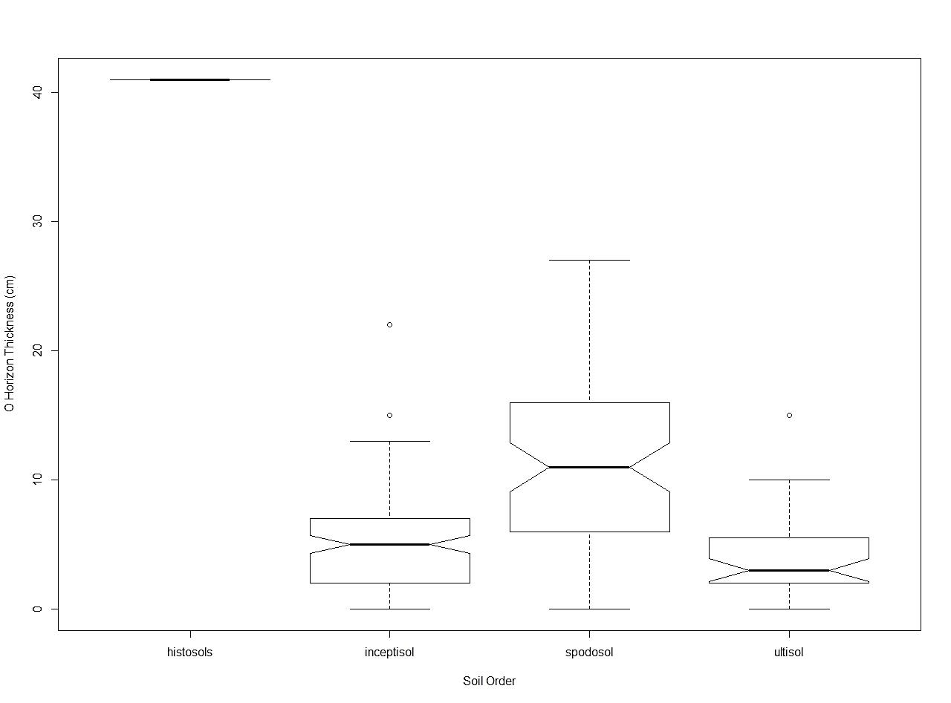
Multivariate Graphical - Boxplots
Boxplot by group
Notes:
Boxplots are robust – work for normal and non-normally distributed data
Quick visualization of relationships
In this example, is there a difference in O horizon thickness by Soil Order?
If notches do not overlap, a reasonable assumption is that medians are different (Chambers, et.al., 1983)
Use “notch=TRUE” when setting plot parameters to get notch
Are the soil orders unique in this relationship?
What can you report with this graph?
What is the data distribution of O horizon thickness for Inceptisols?
(normal, skewed (positive or negative)

Slide 38
Exercise Multivariate
Run:
10_scatterplot_correlation.R
Q&A on scripts 7, 8, 9, 10
Repeat using your own data

Slide 39
References
Chambers, John M., William S. Cleveland, Beat Kleiner, and Paul A. Tukey. "Comparing Data Distributions." In Graphical Methods for Data Analysis, 62. Belmont, California: Wadsworth International Group;, 1983
ESRI ArcGIS. Normal QQ plot and general QQ plot. http://help.arcgis.com/en/arcgisdesktop/10.0/help/index.html#//00310000000q000000
Filliben, J. J. 2004. NIST/SEMATECH e-Handbook of Statistical Methods. http://www.itl.nist.gov/div898/handbook/eda/section1/eda11.htm
Hoskin, T. Parametric and Nonparametric: Demystifying the Terms. Mayo Clinic. http://www.mayo.edu/mayo-edu-docs/center-for-translational-science-activities-documents/berd-5-6.pdf
King, T.S. and R. Lengerich. Statistics 509. Penn State University. https://onlinecourses.science.psu.edu/stat509/book/export/html/155
Seltman, H. 2009. Experimental Design and Analysis. Chapter 4: Exploratory Data Analysis. Carnegie Mellon University. http://www.stat.cmu.edu/~hseltman/309/Book/chapter4.pdf

Slide 40
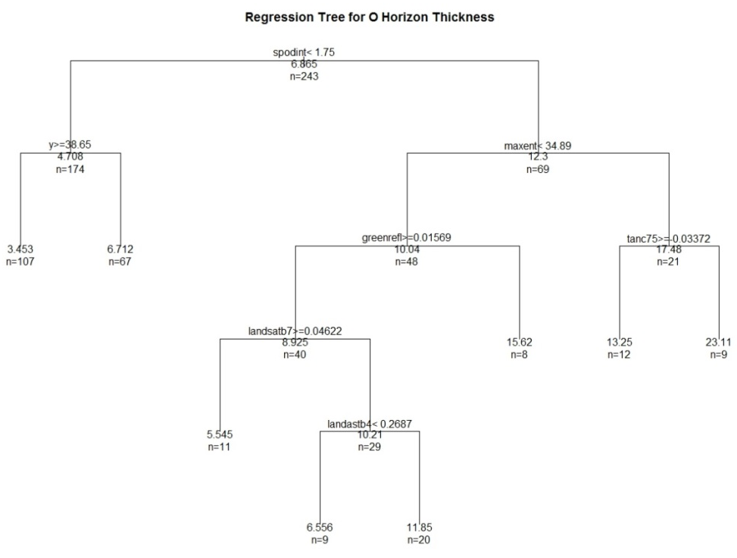
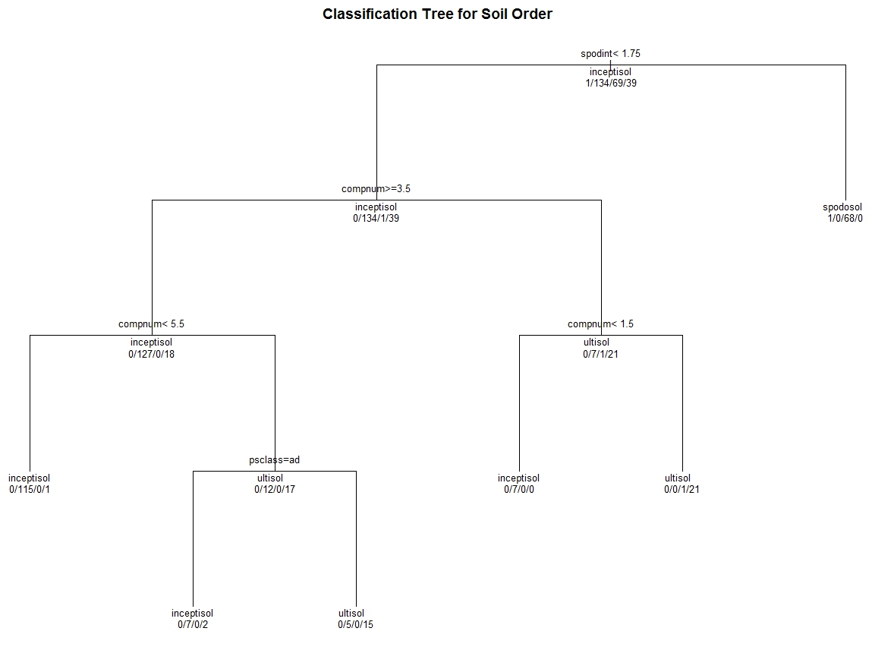
Appendix – Multivariate Graphical Classification Tree

Slide 41
Appendix - Multivariate Graphical Regression Tree

Slide 42
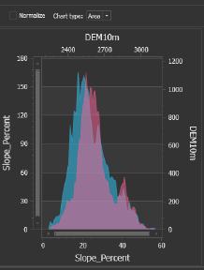
Appendix – Multivariate Graphical TEUI
TEUI = Terrestrial Ecological Unit Inventory
It is an ArcGIS Add-in developed by USFS and can be used to compare data between mapunits

Slide 43
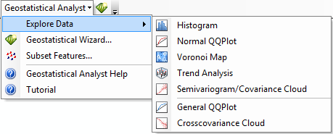
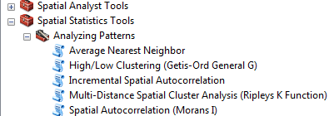
Appendix – EDA in ArcMap
Geostatistical Analyst Toolbar (graphical assessment of normality and covariance)
Spatial Statistics Tool ArcToolbox > Analyzing Patterns (spatial autocorrelation)

Slide 44
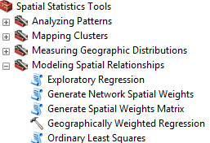
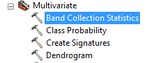
Appendix – EDA in ArcMap
Exploratory Regression (similar to step-wise regression)
Band Collection Statistics (used to calculate Pearson correlation and covariance matrices)

Slide 45
Appendix – Basic EDA Commands in R
Mean: mean(); Median: median(); Standard Deviation: sd(); Range: range(), Minimum: min(); Maximum: max()
Descriptive Statistics for Normality (in fBasics package): dagoTest(variable)
D’Agostino skewness, kurtosis, omnibus, and significance, see: http://help.rmetrics.org/fBasics/test-normalityTests.html for other normality tests
Histogram: hist()
QQPlot: qqnorm() and qqline()
Scatterplot: plot()
Scatterplot Matrix: scatterplotMatrix() in car package
Boxplot: boxplot()

Slide 46
Appendix – Basic EDA Commands in R
Correlation Matrix:
cor(data, method=“kendall”)
cor(data, method=“spearman”)
cor(data, method=“pearson”)
Covariance Matrix:
cov(data, method=“kendall”)
cov(data, method=“spearman”)
cov(data, method=“pearson”)

Slide 47
Appendix – Basic EDA Commands in R
Regression Tree (in rpart package): fit<-rpart(X~Y, method=“anova”)
Classification Tree (in rpart package): fit<-rpart(X~Y, method=“class”)

